Slide 1
Powering AI with Nvidia GPUs
Sai Vishwak

Slide 2
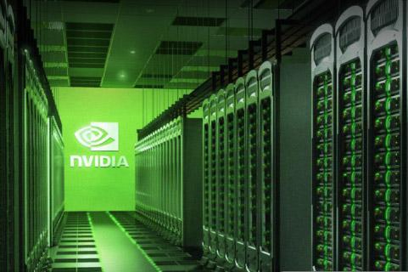
How Nvidia GPUs power the AI
Artificial Intelligence (AI), Large Language Models (LLM) and Generative AI are transforming every industry.
The Advancements in AI are driven by powerful hardware, especially Nvidia GPUs.
Notes:
In today's technology-driven world, AI and LLM technologies are rapidly transforming industries.
While we focus on the software side of AI-algorithms, stats, it's the hardware, specifically GPUs, that truly powers these advances in AI.

Slide 3
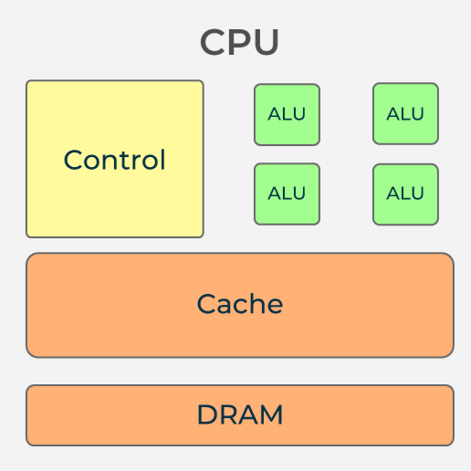
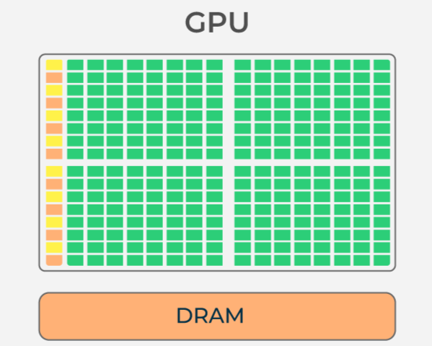
CPU vs GPU
CPU: Few, Powerful cores (2-16)
general-purpose, sequential tasks.
GPU: Thousands of simple cores
Specialized, small, repetitive tasks.
Notes:
A GPU is a processor designed to handle specialized, highly parallel tasks. In contrast, a CPU is designed for generalized tasks with fewer cores.
A CPU has fewer, more powerful cores(2-16), like a few strong workers, whereas a GPU has a large number of simple cores(3000-10,000), like many weak workers.
This difference is what makes CPUs best for general, sequential tasks and GPUs for a large number of simple and repetitive tasks which needs to be executed simultaneously.

Slide 4
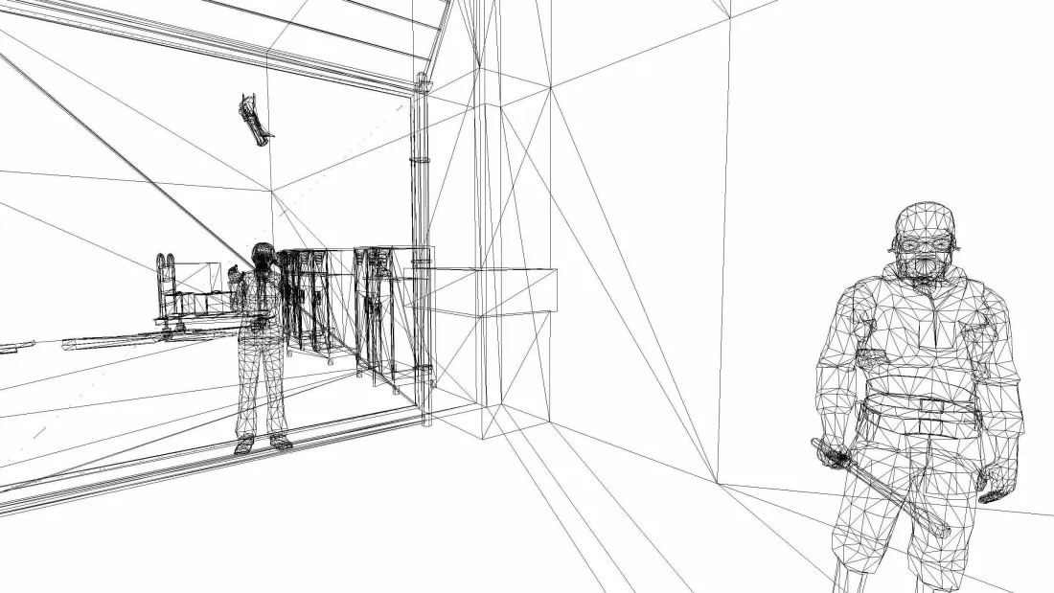
Why were GPUs invented?
Created for 3D graphics rendering and gaming.
Process millions of pixels and data points in parallel.
Engineered for simultaneous data processing.
Notes:
GPUs were originally invented to tackle the parallel workload of graphics rendering in video games and 3D applications.
The GPU architecture was engineered to process these massive pixel data simultaneously, effectively performing parallel computing.
This architecture also makes GPUs suited for other problems that require parallelism.

Slide 5
Parallel Processing
GPUs divides tasks into thousands of sub-tasks called Threads.
Each sub-task runs at same time, independently.
Ideal for repetitive, data-heavy calculations.
Sub Task-1
Processor-1
Task
Sub Task-2
Processor-2
Sub Task-3
Processor-3
Notes:
GPUs can spread a single task across thousands of cores(mini-workers), where these sub-tasks are processed/executed simultaneously, independent of each other.
This capability is known as Parallel Processing

Slide 6
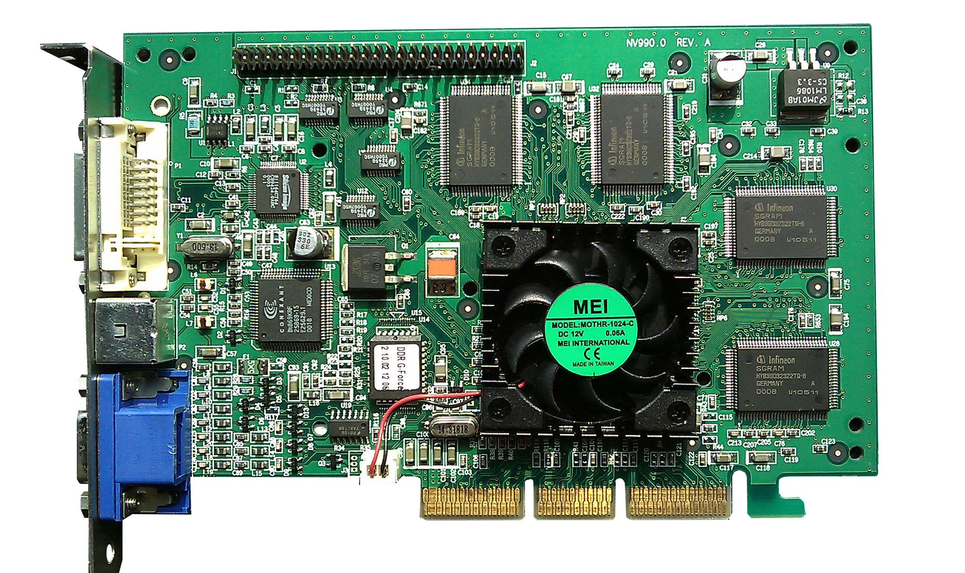
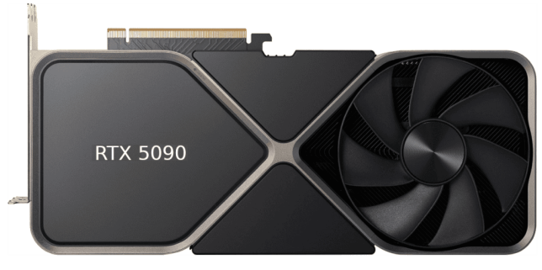
History of Nvidia GPUs
GeForce 256:
First Nvidia GPU (1999) with 32 MB of memory.
Purpose built for real-time 3D rendering.
RTX 5090:
Latest GeForce GPU with over 20,000 CUDA cores and 32 GB of memory.
Built for Gaming, 3D rendering, Video Editing, and AI.
Notes:
Nvidia revolutionized the GPU market with the launch of GeForce 256 in 1999, the first GPU with 32 mb memory. It was purpose-built for real-time 3D rendering and gaming.
Today's top-end GeForce GPU is RTX 5090, which has over 20000 cores with 32 GB of memory. It is built for Gaming, 3D rendering, Video Editing, and AI.

Slide 7
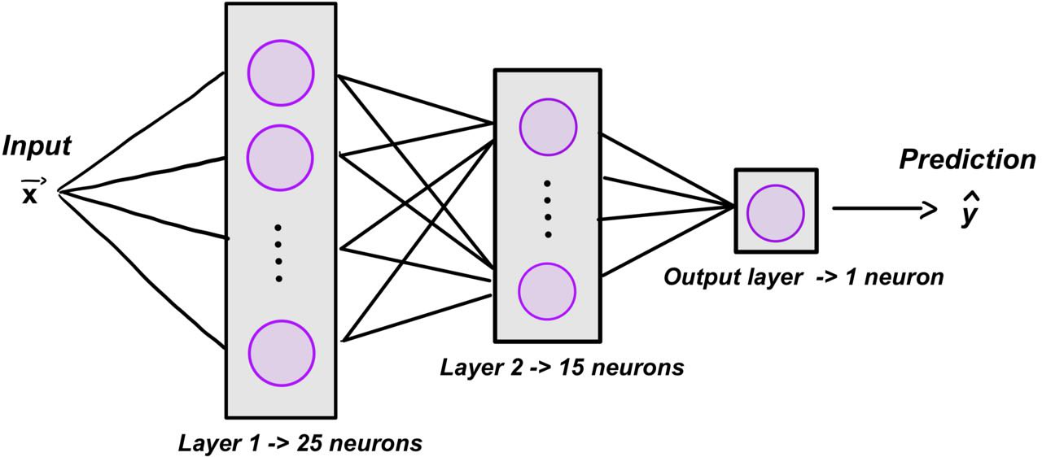
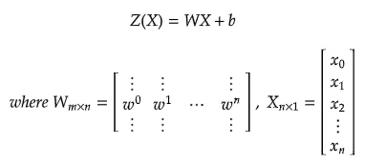
Nvidia GPUs for AI/LLM
AI and Deep learning need huge, repetitive calculations (matrix multiplications).
GPU’s architecture were designed for these tasks.
This improves the training and inference in AI/LLM.
Notes:
AI and deep learning tasks require a massive number of mathematical calculations, like matrix multiplication.
Training or Inferencing these models involves repetitive calculations, which can be divided into small, independent tasks.
Which is why training and inference in AI and LLMs are well-suited for parallel processing.

Slide 8
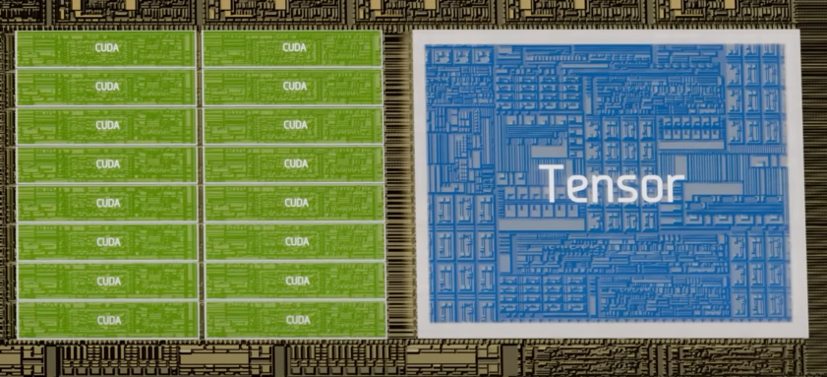
Nvidia’s GPU Innovations
CUDA: Compute Unified Device Architecture
CUDA cores are designed for parallel computing.
Tensor:
Tensor cores are optimized for matrix calculations. More efficient than CUDA cores.
Notes:
Nvidia developed the CUDA(Compute Unified Device Architecture) platform to allow programmers to utilize the GPU for these parallel tasks.
CUDA divides a single task into thousands of threads and executes the task simultaneously, independent of each other.
CUDA cores are the sub-workers inside a GPU which execute these sub-tasks parallelly.
To push performance further, Nvidia created Tensor cores for the needs of ML, DL, which are more efficient at matrix calculations than CUDA cores.
These Tensor cores are utilized for the tasks of AI and LLM for performing the Matrix Multiplication, improving the Training and Inference

Slide 9
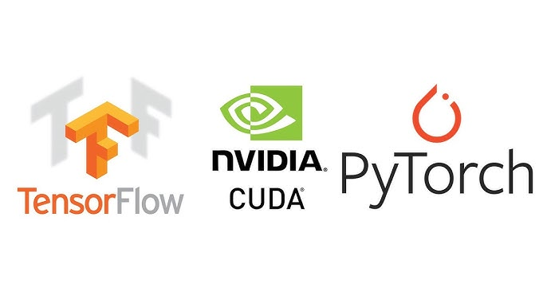
Frameworks for CUDA
TensorFlow and PyTorch Frameworks utilize CUDA platform to exploit Nvidia GPU’s capabilities and perform Parallel computing.
Faster training and inference for deep learning and LLMs.
Notes:
Because of these advancements, frameworks like Tensorflow(Google) and PyTorch(Meta) are developed to utilize Nvidia GPU and CUDA capabilities to perform parallel computing.
Which improves the training and inference in DL and LLM.

Slide 10
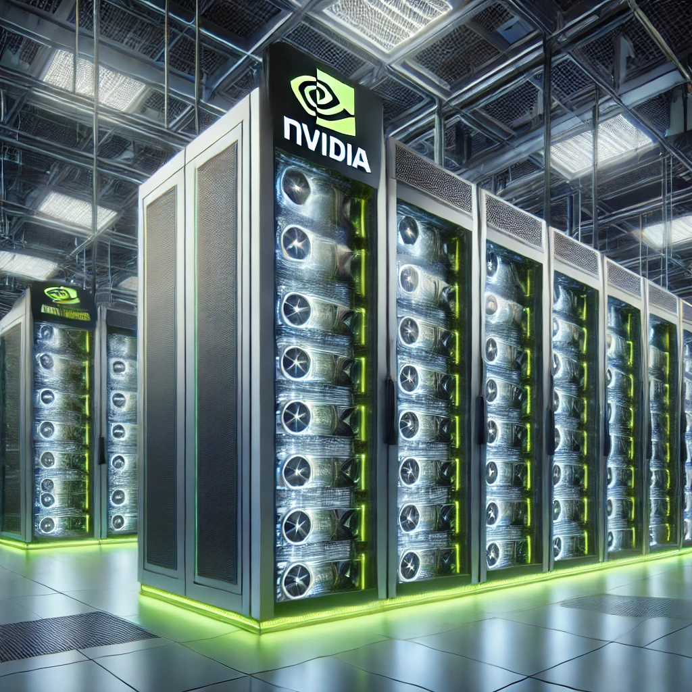
Impact of AI on Nvidia
Nvidia partners with Big Tech for AI and GPU advancements.
Massive demand for AI-optimized GPUs drives Nvidia’s growth.
Nvidia has shifted it’s focus from consumer graphic market to Data center and AI-optimized enterprise GPU market.
Notes:
Today, Nvidia and AI companies are partnering to bring advancements in AI capabilities and the GPU market.
The boom in AI, LLM, and GenAI has shifted Nvidia's business from serving the consumer graphics market to providing high-powered GPUs for AI workloads in data centers to enterprise customers.

Slide 11
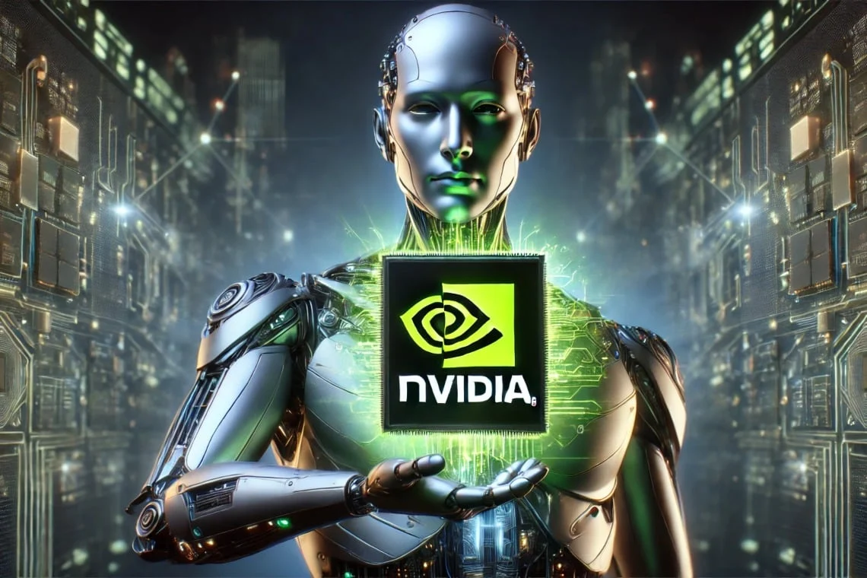
Conclusion
Nvidia GPUs fuel the innovation in AI and LLM industry.
Their parallel design drives advances in machine learning, deep learning, and generative AI.
Notes:
In summary, the progress we currently see in AI wouldn't be possible without the hardware advancements provided by Nvidia's GPUs.
Their parallel architecture has helped breakthroughs in ML, DL, and GenAI.

Slide 12
THANK YOU

